Slide 1
Surgical Quality
JoAnn Vuong, Theresa Aguilar, Jeff Thornhill
04.28.2021

Slide 2
Agenda
Background
Objectives
What is NSQIP?
Measures
Methodology
Flow Chart
Data Collection
Profiling
Data Transformation
Consort
Findings

Slide 3
Background

Slide 4
Objectives
Identify 6 quality measures from NSQIP
Use Medicare Claims Synthetic Public Use Files (SynPUFs)
Prepare the data for computing these 6 measures
Evaluate feasibility

Slide 5

What is ACS NSQIP
American College of Surgeons National Surgical Quality Improvement Program
Provides participating hospitals with tools, analyses, and reports to make informed decisions about improving quality of care
From the patient’s medical chart, not insurance claims
Risk-adjusted
Case-mix-adjusted
Based on 30-day patient outcomes

Slide 6
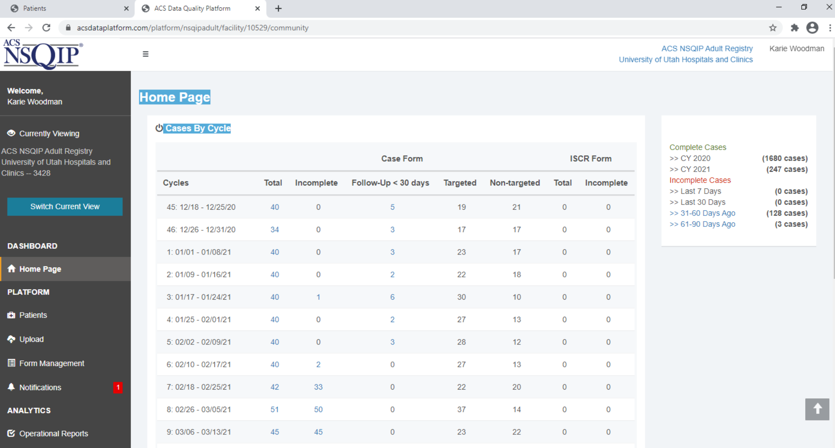
Data are entered online in a HIPAA-compliant, secure, web-based portal, accessible 24 hours a day by a trained Surgical Clinical Reviewer.
*Screen shot courtesy of Karie Woodman, ACS NSQIP contact for the University of Utah

Slide 7
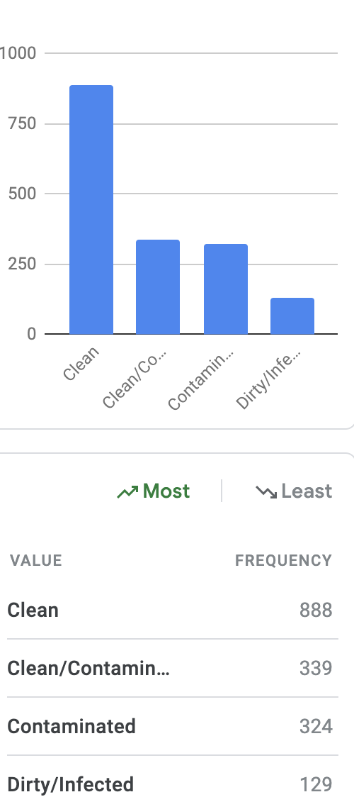
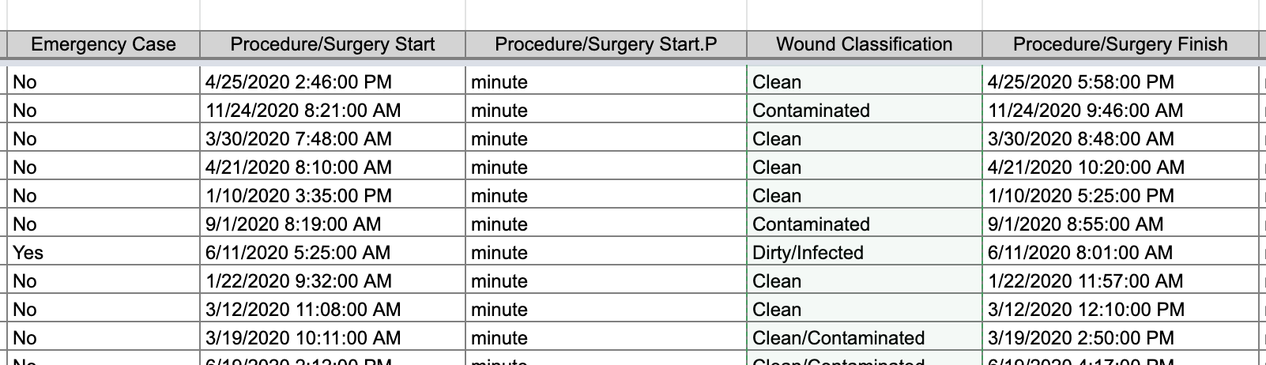
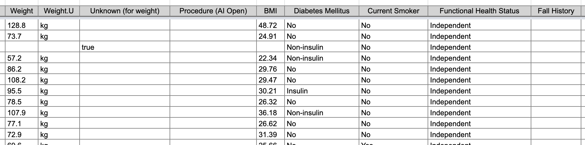
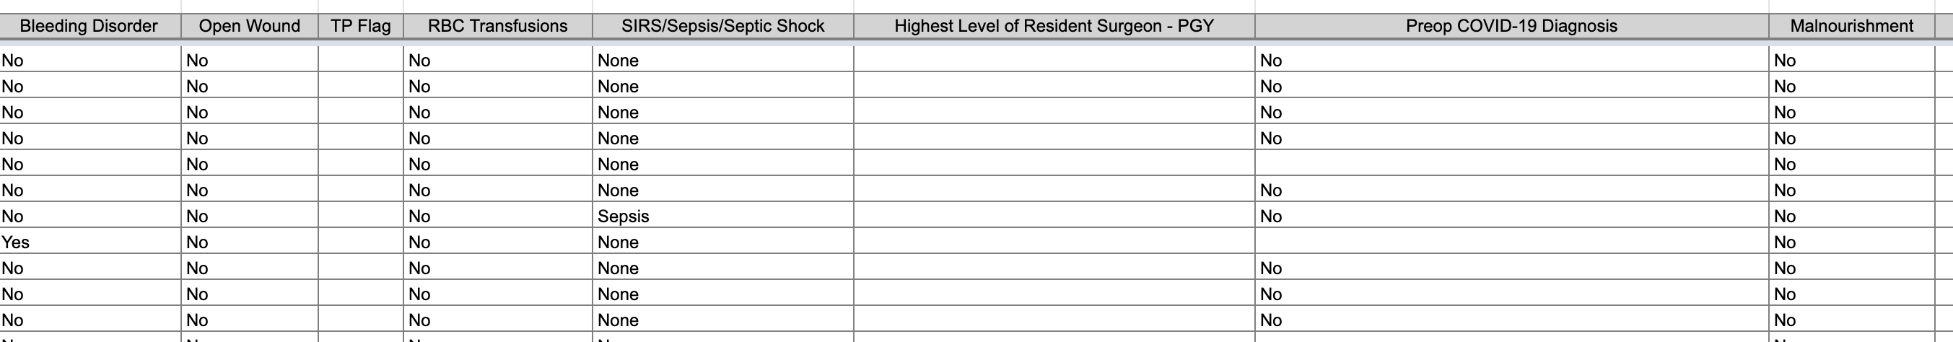
Deidentified Digital Download Example
*File courtesy of Karie Woodman, ACS NSQIP contact for the University of Utah

Slide 8


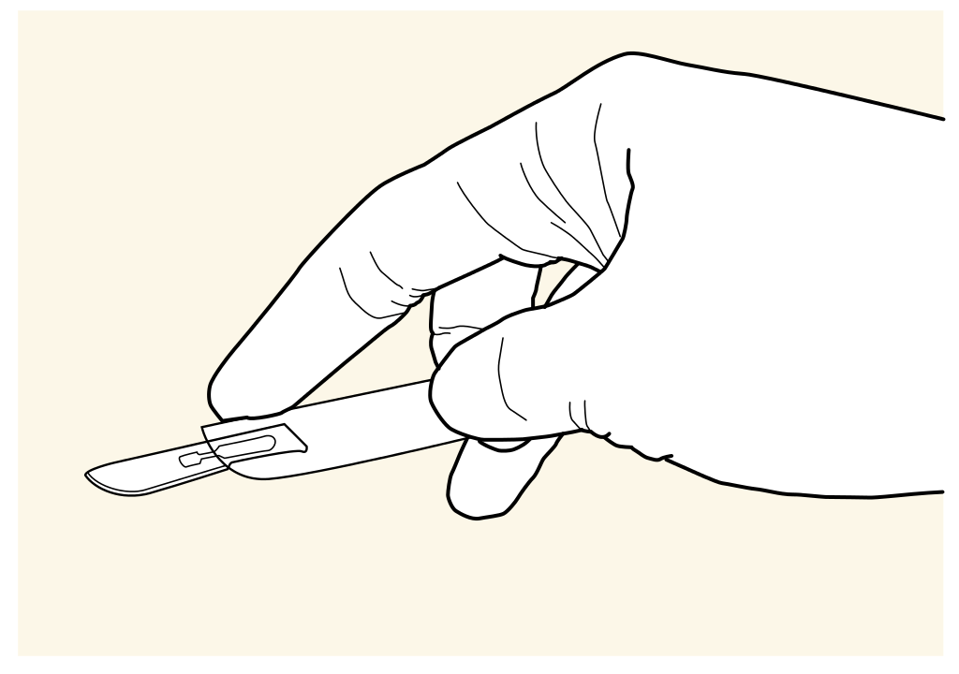
Measures
Colon surgery.
Deep vein thrombosis or pulmonary embolism after vascular or general surgery.
Urinary tract infection.
Pneumonia following vascular or general surgery.
Sepsis after general or vascular surgery.
Death within 30 days following vascular or general surgery.
diagnosis
procedure
timeline
Notes:
Patients that have a vascular or general surgery must come back within 30 days with a qualifying diagnosis to be considered for NSQIP

Slide 9
Urinary tract infection
Definition: A urinary tract infection (UTI) is an infection that affects any part of the urinary tract, consisting of the kidneys, ureters, bladder and urethra. The most common type of UTI is a bladder infection. This measure tracks patients who experienced urinary tract infection after general or vascular surgery.
Inclusion Criteria:
ICD-9-CM: 39.0, 59.90
Exclusion Criteria:
None.

Slide 10
Deep Vein Thrombosis
Definition: A deep vein thrombosis(DVT)or a pulmonary embolism(PE)can be a serious complication after surgery. Sometimes a deep vein thrombosis can lead to a pulmonary embolism which is a blood clot that has been dislodged but then gets stuck in the lungs causing a disruption in blood flow. The Deep Vein Thrombosis or Pulmonary Embolism NSQIP measure is calculated by determining the number of patients who had vascular or general surgery that came back with a DVT or PE.
Inclusion Criteria:
DVT: 453.40, 453.90, 453.41, 453.42, 997.1, 997.49, 997.39, 997.2, 999.9, 997.71
PE: 415.11
Blood Clots: 453.40, 997.2, 997.1, 997.49, 998.9, 569.62
Exclusion Criteria:
None

Slide 11
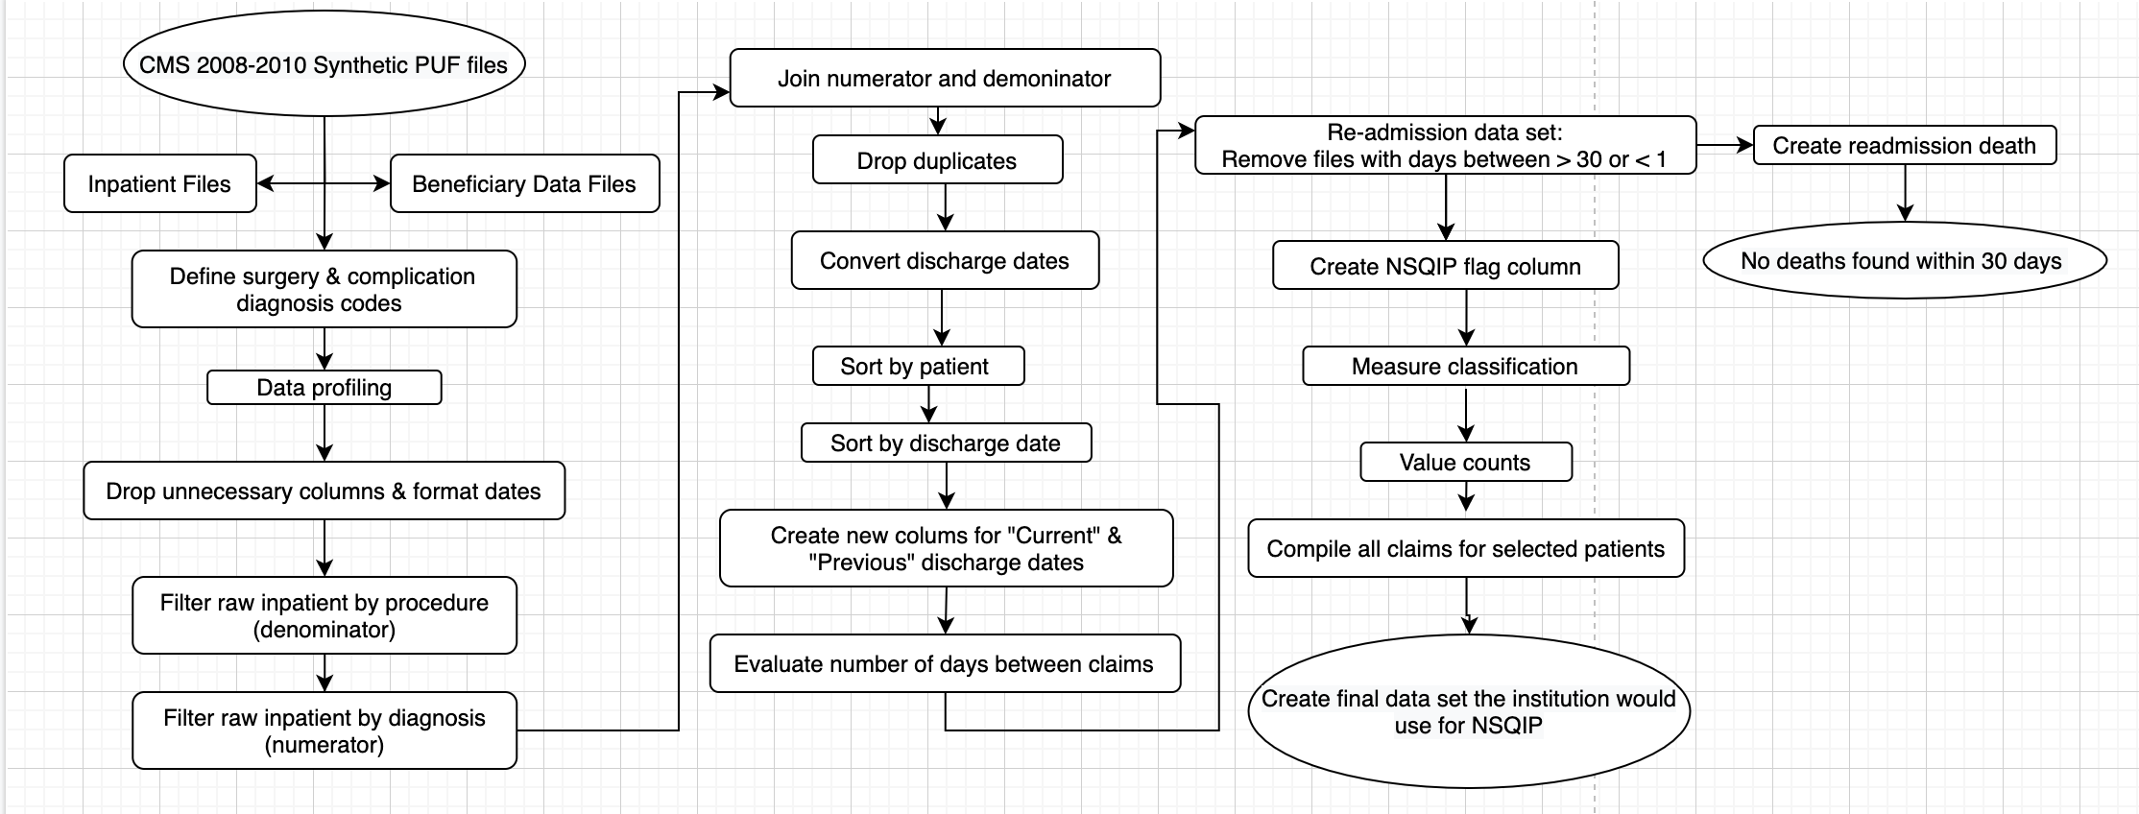
Flow Chart

Slide 12
Methodology
Notes:
Now we are going to talk about how we collected the data, cleaned/formatted and explored the data for NSQIP measures.

Slide 13
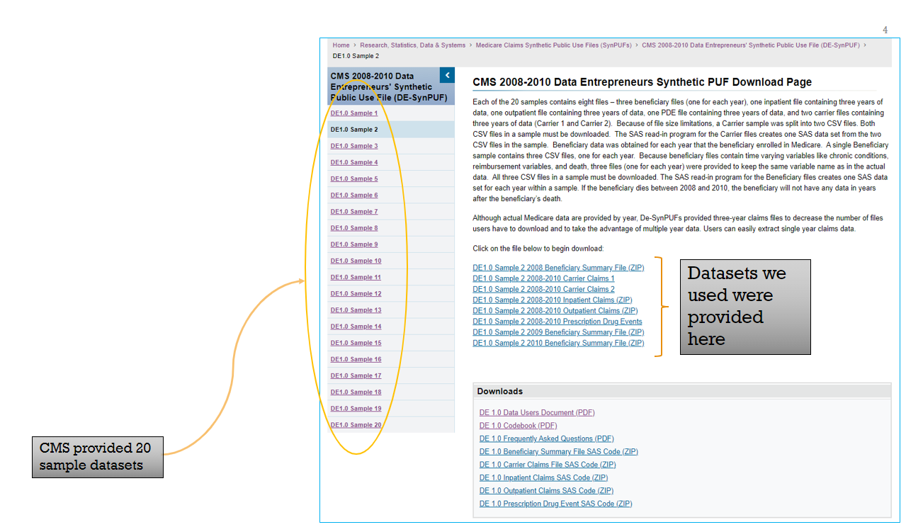
CMS Synthetic PUF Files
Timeframe:
2008 – 2010
Types of claim files
Beneficiary
Inpatient
Outpatient
Available Code sets
ICD9_Dx
ICD9_Px
HCPCS
Notes:
- We got these files from the CMS.gov website
- The data ranges from 2008 through 2010 which means that we were focused on ICD-9 diagnosis and procedure codes.
- This is an example of where we pulled the files down. The files were provided in 20 sample zip files that contained Beneficiary, Inpatient and Outpatient datasets.
- Each of us downloaded one of the sections and combined the individual files into consolidated datasets. (Screenshot of master inpatient on next slide).

Slide 14
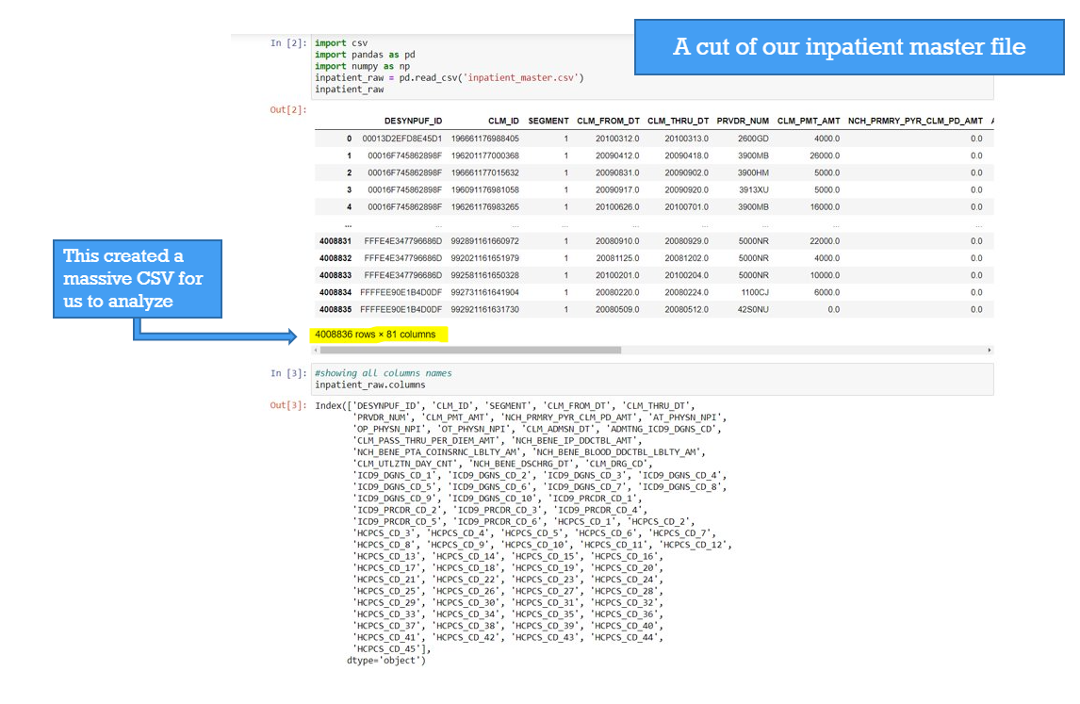
Aggregated Datasets

Slide 15
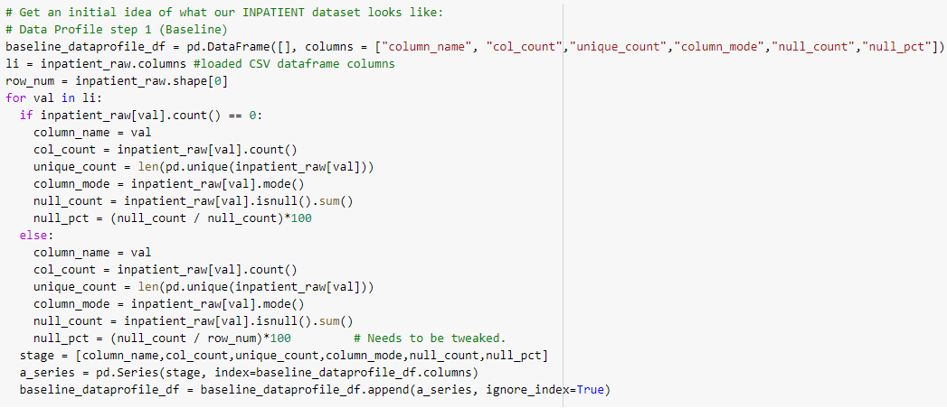
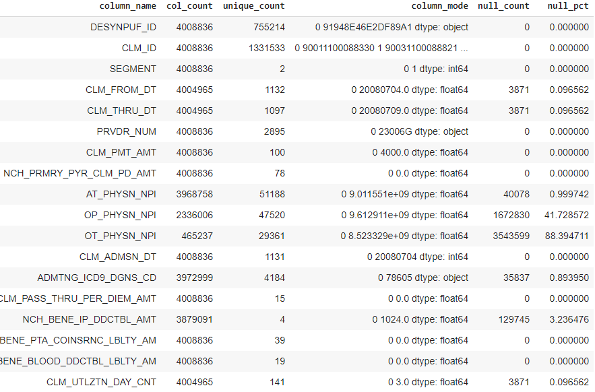
Data Profiling (Inpatient)
Inpatient

Slide 16
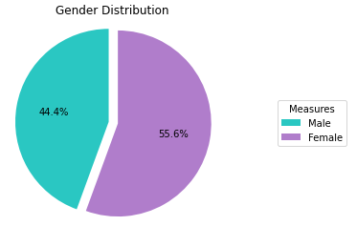
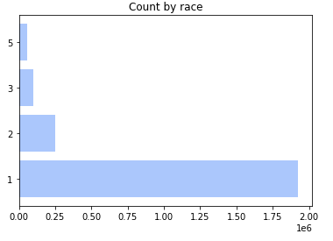
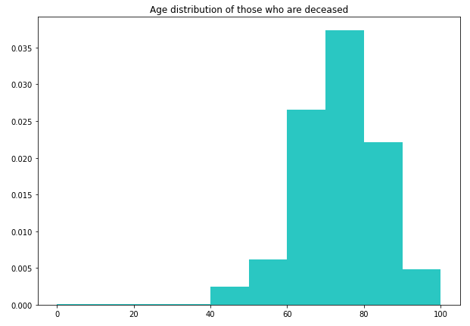
Data Profiling (Beneficiary)
Beneficiary Dataset
Number of records (Pre): 15,573,396
Number of columns: 32
Number of deceased:136,383

Slide 17
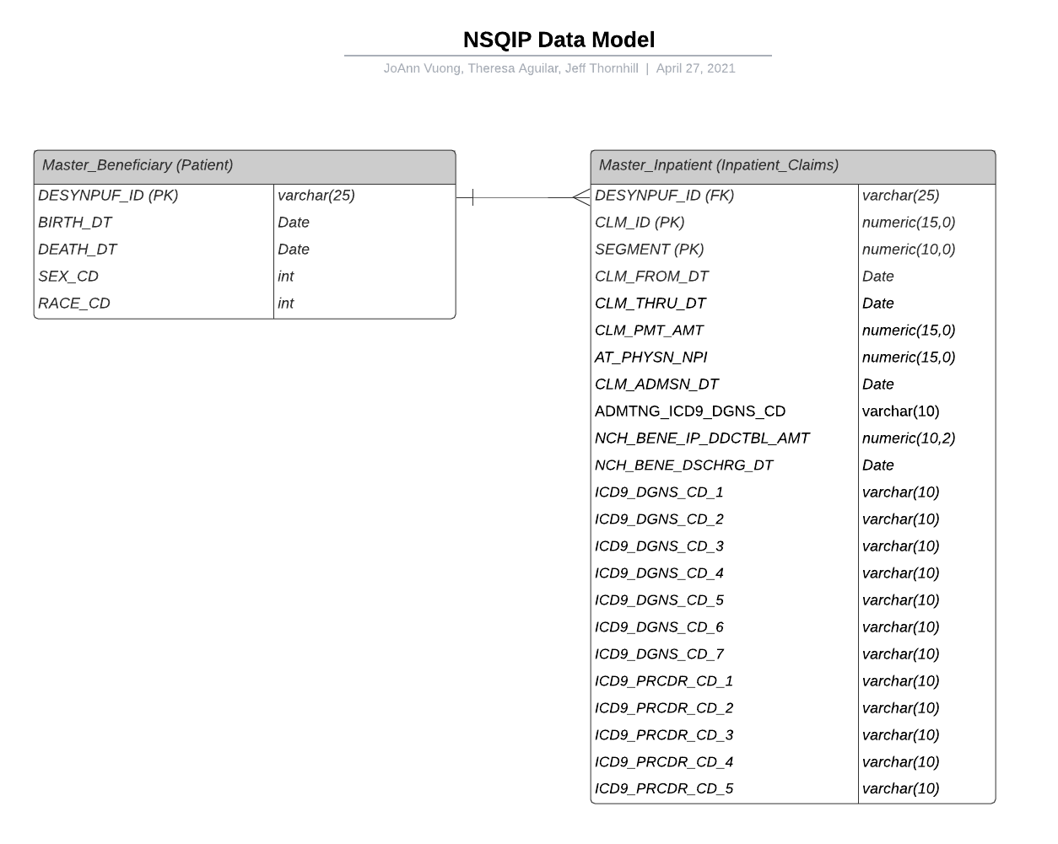
Focused Datasets
Beneficiary Dataframe
DESYNPUF_ID
BIRTH_DT
DEATH_DT
SEX_CD
RACE_CD
Inpatient Dataframe
DESYNPUF_ID
CLM_ID
SEGMENT
CLM_FROM_DT
CLM_THRU_DT
CLM_PMT_AMT
AT_PHYSN_NPI
CLM_ADMSN_DT
ADMTNG_ICD_DGNS_CD
NCH_BENE_IP_DDCTBL_AMT
NCH_BENE_DSCHRG_DT
ICD9_DGNS_CD_1 – 9
ICD9_PRCDR_CD_1 - 9
Notes:
Output based on data profiling results as to what columns were needed and well populated as well as what might be useful in data analysis.

Slide 18
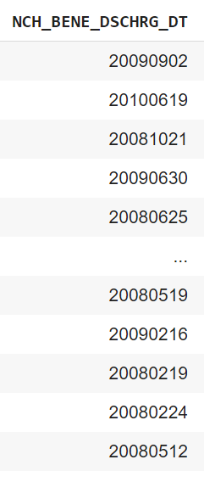
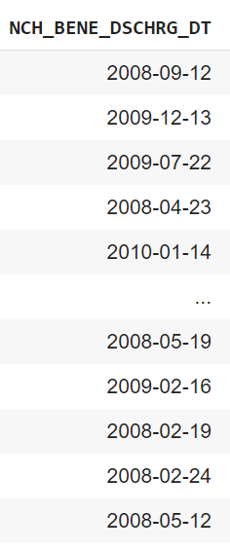
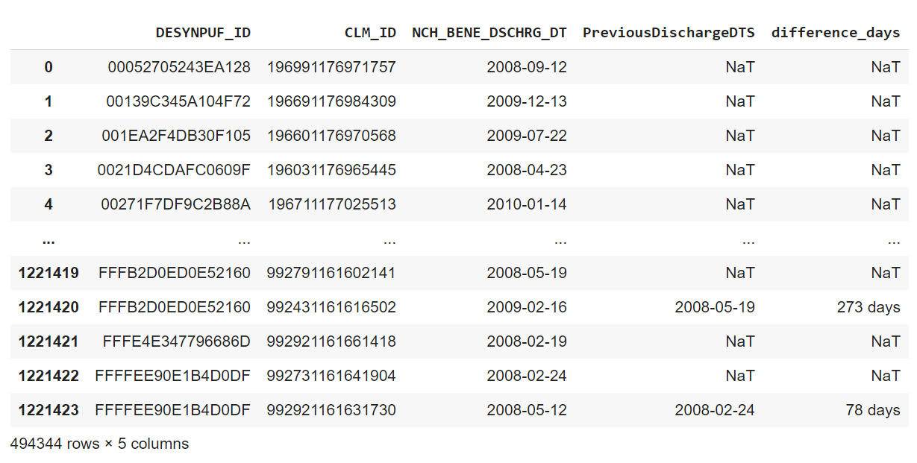
Data Transformation
Formatted date
Calculated # of days
Formatting dates
Creating a previously discharged date column to find the difference of days between claims

Slide 19
Date Diff Logic
with the NCH_BENE_DSCHRG_DT and the PreviousDischarge dates in the same row, we can then calculate the days between
Dataframe is first sorted by patient
It is then sorted by date
If the same patient has multiple discharge dates, the previous discharge date is copied into this column
Notes:
Sorted by patient > Sorted by Discharge Date > Create a previously discharged date column and use the dates to calculate the days between

Slide 20
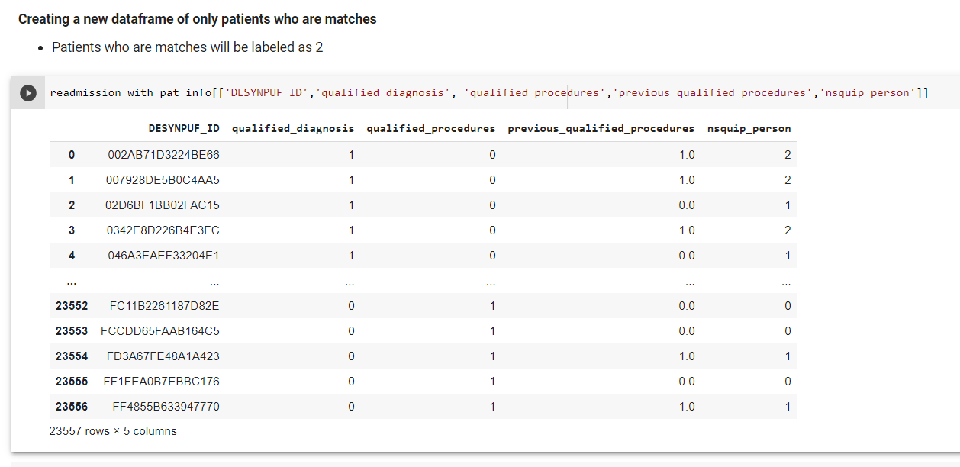
Custom Columns
Notes:
We flagged patients with a qualified diagnosis and qualified procedures with a 1. We then created a column called nsqip person, which

Slide 21
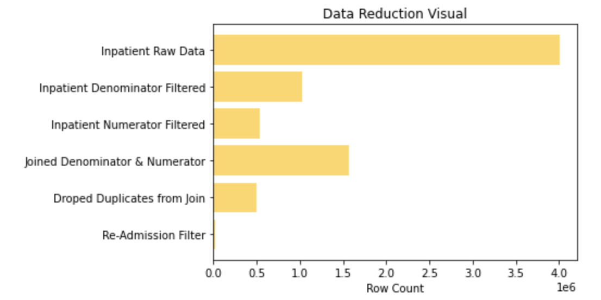

Slide 22
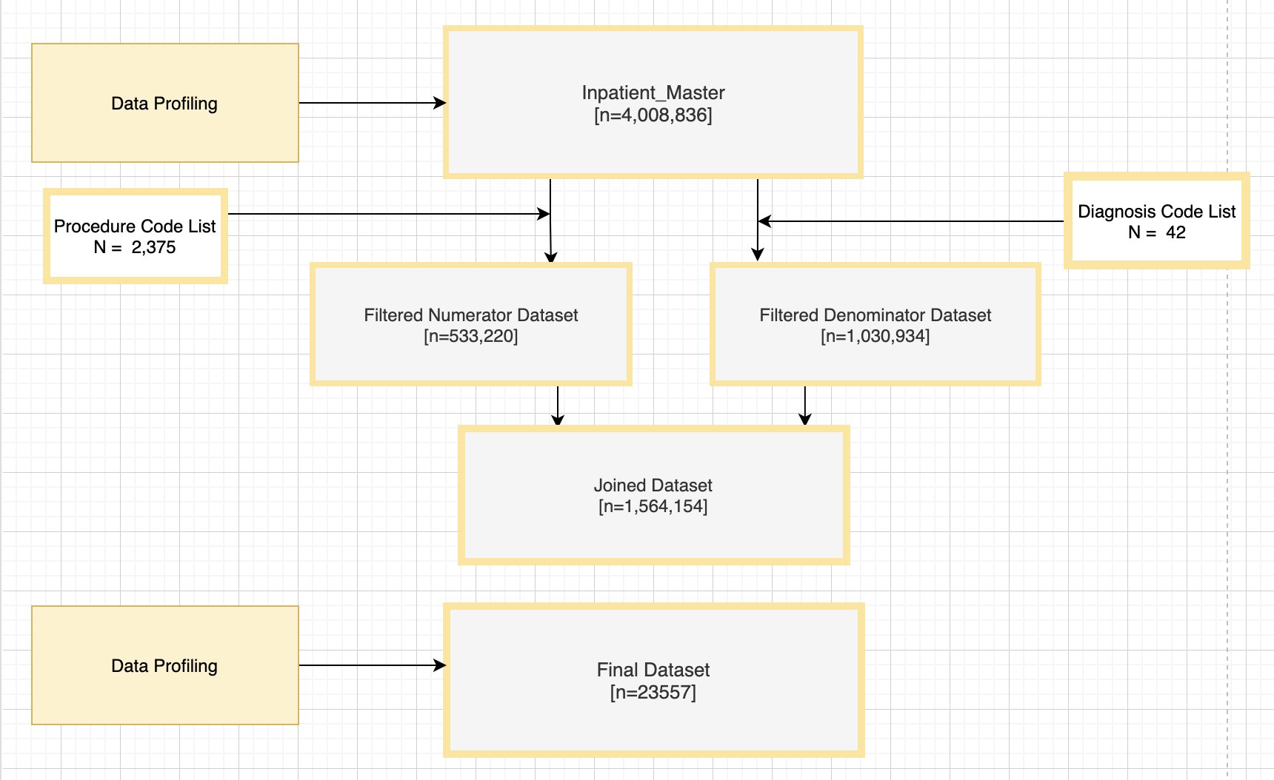
Consort

Slide 23
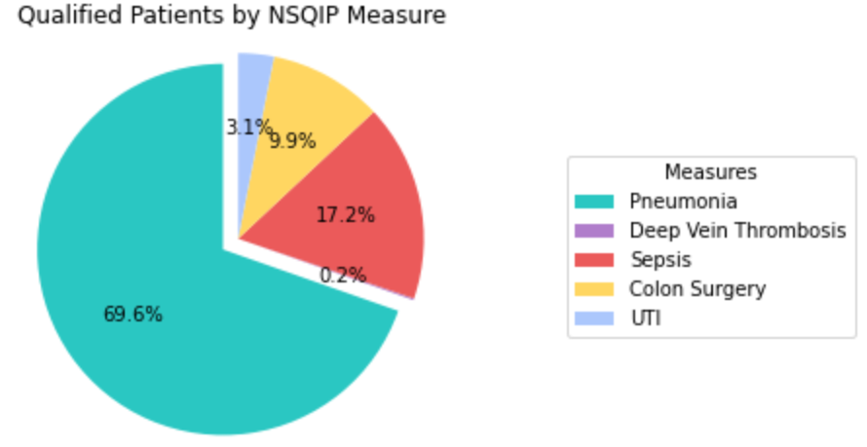
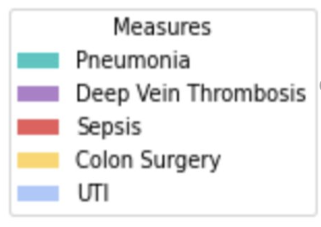
Findings
Measure | Numerator | Denominator | Rate
Pneumonia | 3678 | 23557 | 15.6%
Sepsis | 908 | 23557 | 3.8%
Colon | 524 | 23557 | 2.2%
UTI | 164 | 23557 | 0.69%
Deep Vein | 8 | 23557 | 0.03%
Death | 0 | 23557 | 0%
Pneumonia has the highest complication post surgery
Due to the population being predominantly 65+.
Notes:
After getting our denominator and filtering for patients that were qualified with a diagnosis, we found that our highest returning diagnosis was pneuomia, followed by sepsis. Looking at the piechart: Of the total people that had a qualifying diagnosis, 70% of them had pneumonia. The high pneumonia percentage could be due to the high volume of patients that are 65 years or older.

Slide 24
Summary
Understanding what we were trying to do was a big part of the project
Evaluating data before an action plan is developed helps
Be prepared to modify the plan
Although it is possible to use Medicare SynPUFs to provide qualified data to NSQIP it doesn't provide a complete story

